Slide 1
English Premier League project
Using Graph Algorithm

Slide 2
Team members:
Alaa Ahmed Ibrahim
Zeinab Ahmed Younes
Sayed Ibrahim Sayed
Mariem Medhat
Yomna Waleed

Slide 3
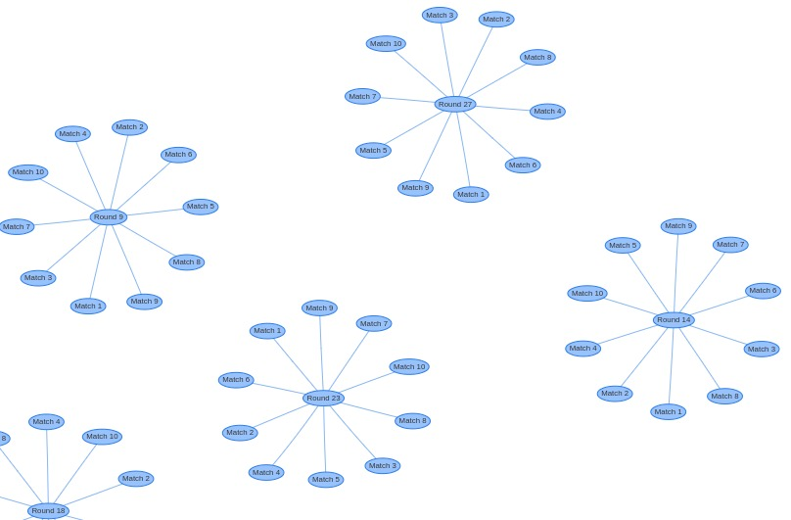
The Graph

Slide 4
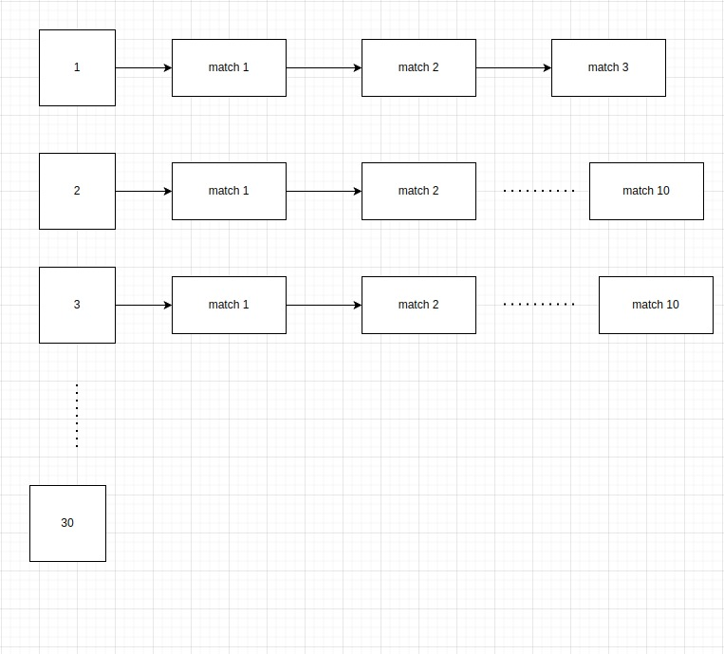
The Adjacency list

Slide 5
Code Analysis

Slide 6
const fs = require('fs');
const readline = require('readline');
class Graph { O(1)
constructor() {
this.nodes = {};
} addNode(round) { O(1)
if (!this.nodes[round]) {
this.nodes[round] = [];
}
} O(1) addEdge(round, match) { O(1)
if (!this.nodes[round]) {
this.addNode(round);
} this.nodes[round].push(match);
} getMatchesByRound(round) { O(1)
return this.nodes[round] || [];
}
}

Slide 7
function parseDate(dateString) {
const parts = dateString.split('/');
const day = parseInt(parts[0])+1;
const month = parseInt(parts[1])-1 ; O(n)
const year = parseInt(parts[2]);
return new Date(year, month, day); n : length of dateString
}

Slide 8
function buildGraph(filename) {
const graph = new Graph();
const fileData = fs.readFileSync(filename, 'utf-8');
const lines = fileData.split('\n');
lines.forEach(line => {
const [round, date, homeTeam, awayTeam, homeGoals O(p)
awayGoals, result] = line.split(',');
p: number of parts in const match = { each line
round:parseInt(round),
date:parseDate(date), O(M*p)
homeTeam,
awayTeam,
homeGoals:parseInt(homeGoals), M :no. of matches
awayGoals: parseInt(awayGoals),
result
};
if(homeGoals != '-' ){
graph.addNode(match.round);
graph.addEdge(match.round, match); }
});
return graph;
}

Slide 9
function calculateTeamStatisticsByDate(graph, date) {
const EachRound = {};
const visitedMatches = new Set();
function traverseMatches(round) {
const matches = graph.getMatchesByRound(round); O(r)
for (const match of matches) { O(m)
if (!visitedMatches.has(match)) {
visitedMatches.add(match); O(r*m)=O(M)
const { round, date: matchDate, homeTeam, awayTeam,
homeGoals, awayGoals, result } = match;
... M: no. of all matches
r : number of rounds
m : number of matches
in each round
traverseMatches(round + 1); O(r) k : no. of teams
const sortedResult = Object.entries(EachRound).sort((a, b) =>
b[1].points - a[1].points); O(k*logk)
}

Slide 10
const rl = readline.createInterface({
input: process.stdin, O(1)
output: process.stdout
});
rl.question('Enter "round" or "date": ', (answer) => {
if (answer === 'round') {
rl.question('Enter round number: ', (round) => { O(1)
const graph = buildGraph('results.csv');
const cal = calculateTeamStatistics(graph, parseInt(round));
console.log(cal);
rl.close();
}); O(1)
} else if (answer === 'date') {
rl.question('Enter date (format: DD/MM/YYYY): ', (date) => {
const graph = buildGraph('results.csv');
const cal = calculateTeamStatisticsByDate(graph, date); O(1)
console.log(cal);
rl.close();
});
} else {
console.log('Invalid input'); O(1)
rl.close();
}
});

Slide 11
The previous function (traverseMatches) follows Depth First search graph traversal method to calculate the wanted data

Slide 12
The Overall Complexity of code :
O(M*p)
where :
M no. of all matches
p parts of the line

Slide 13
Thanks

